Slide 1
Enterprise Architecture
Management of ICT

Slide 2
Enterprise Architecture (EA)
Enterprise - the whole complex, socio-technical system, including people, information, processes and technologies; (Giachetti, 2010)
Architecture - a high-level or abstract description of the enterprise as a system – its boundary, the products and services it provides, and its internal structures and behaviours, both human and technical. An architectural description contains a variety of lists, tables and diagrams. These are models known as views.

Slide 3
What is EA?
A well-defined practice for conducting enterprise analysis, design, planning, and implementation, using a holistic approach, for the development and execution of strategy.
Applies architecture principles and practices to guide organisations through the business, information, process, and technology changes necessary to execute their strategies.

Slide 4
EA- MIT Centre for IS Research, 2007
The organizing logic for business processes and IT infrastructure reflecting the integration and standardisation requirements of the company's operating model. The operating model is the desired state of business process integration and business process standardisation for delivering goods and services to customers.
It is not the process of examining the enterprise, rather the documented results of that examination. (US Code Title 44)

Slide 5
EA - US Code – Title 44, 2011
‘Strategic information base' that defines the mission of an agency and describes the technology and information needed to perform that mission, along with descriptions of how the architecture of the organisation should be changed in order to respond to changes in the mission.

Slide 6
EA - Gartner IT Glossary, 2013
A discipline for proactively and holistically leading enterprise responses to disruptive forces by identifying and analysing the execution of change toward desired business vision and outcomes.
EA delivers value by presenting business and IT leaders with signature-ready recommendations for adjusting policies and projects to achieve target business outcomes that capitalise on relevant business disruptions.
EA is used to steer decision making toward the evolution of the future state architecture.

Slide 7
EA School of Thoughts
To figure out the best strategies to support and enable business development and business change.
To align IT and business concerns.
To guide the process of planning and design the IT/IS capabilities of an enterprise in order to meet desired organisational objectives.
To link between strategy formulation and execution.
To foster and maintain the learning capabilities of enterprises so that they may be sustainable.

Slide 8
An Enterprise Architect
A person responsible for performing this complex analysis of business structure and processes and is often called upon to draw conclusions from the information collected.

Slide 9
EA Defines …
What an organization does;
How the organisational functions are performed;
How information are captured, used and stored;
Who performs individual functions within the organisation, and within the market value chain;
Where the function are performed; and
What budget is required;
Why you need to do this;
When you need to do this.

Slide 10
EA Scope - ISO, 2011
EA models describe:
The logical business functions or capabilities,
Business processes
Human roles and actors
The physical organisation structure
Data flows and data stores
Business applications and platform applications
Hardware and communications infrastructure

Slide 11
EA Motivations
Alignment of IT with Business - strategies, processes, regulations, …
Governs systems lifecycle - planning, development, maintenance
Reduce maintenance costs
Ensure systems in accordance business
Guarantee an integrated IT environment - consistent, accurate, correct
Prevent redundancy
Interoperability, flexibility, …ilities!

Slide 12
EA Enables Change Through
Innovations in the structure or processes
Innovations in the use of IS/IT
Integration and/or standardisation of business processes
Improving the quality and timeliness of business information.

Slide 13
EA Framework
A tool that defines how to create and use an enterprise architecture.
It structures architects' thinking by dividing the architecture description into domains, layers or views, and offers models - typically matrices and diagrams - for documenting each view.
Provides a structured collection of processes, techniques, artefact descriptions, reference models and guidance for the production and use of an enterprise-specific architecture description.

Slide 14
EA Framework tools
BSP - IBM’s Business Systems Planning (1982)
Zachman - ISA/EA Framework (1987, 1992)
EAP - Enterprise Architecture Planning - Spewak (1993)
TOGAF – The Open Group Architecture Framework (1994)
FEAF – Federal Enterprise Architecture Framework (1998)

Slide 15
Business Systems Planning (BSP)
A method for analysing and designing an organisation’s information architecture, with the goals to:
understand the issues and opportunities with the current applications and technical architecture;
develop a future state and migration path for the technology that supports the enterprise;
provide business executives with a direction and decision making framework for IT capital expenditures;
provide information system (IS) with a blueprint for development.

Slide 16
the Zachman Framework
Reading:
The Zachman Framework Evolution -http://www.zachman.com/ea-articles-reference/54-the-zachman-framework-evolution

Slide 17
The Zachman Framework (ZF)
One of the origins of EA
EA is like a jungle of models
Maps are required to not get lost!
ZF is such a map for this jungle
The most used framework for EA and related arenas

Slide 18
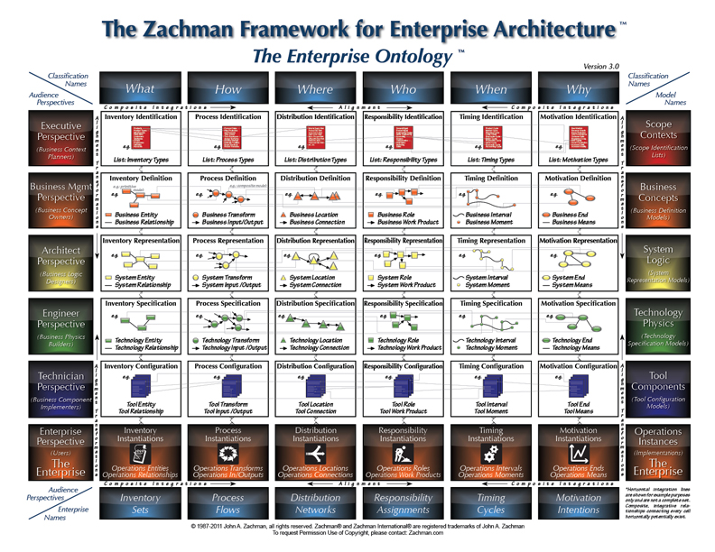

Slide 19
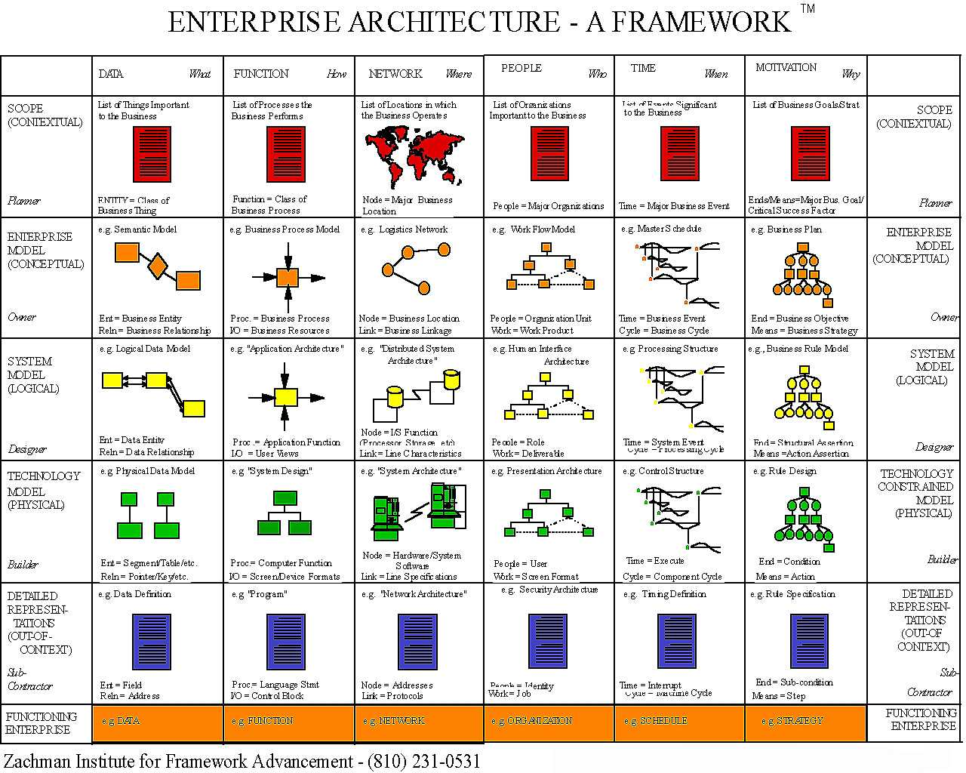
The Zachman Framework
Data What
Function How
Network where
People Who
Time When
Motivation Why
Scope
(Contextual)
Planner
Business
(Conceptual)
Owner
System
(Logical)
Designer
Technology
(Physical)
Builder
Components
(Detailed)
Sub-Contractor
Enterprise

Slide 20
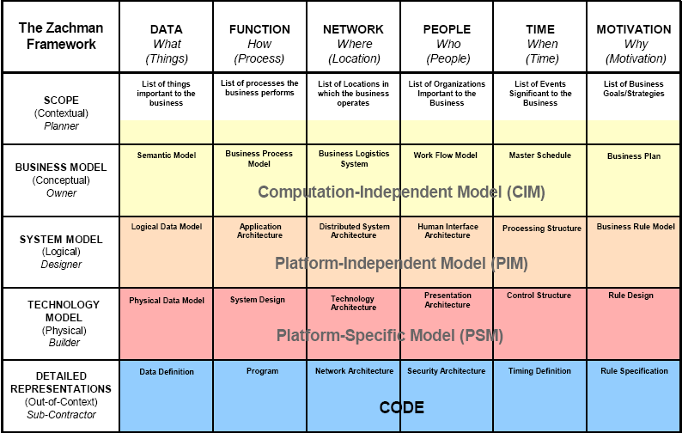
MDA vs. ZF: Separation of Concerns
http://www.omg.org/mda/mda_files/09-03-WP_Mapping_MDA_to_Zachman_Framework1.pdf

Slide 21
Challenges of using ZF
Engineering and reengineering perspectives from each other
Different languages and standards coming from different sources
Works have been done on:
Applying UML to ZF
Assigning MDA-based models to ZF

